Slide 1
Bloomsberg Project
Atufa Shireen

Slide 2
Approach
The document is created by extracting paragraphs from each of the article using beautifulsoup.
Text preprocessing is performed on the document,
Lowering the text.
Removing punctuations.
Removing stop words.
Removing numbers.
Lemmatization of words
The TFIDF, or term frequency–inverse document frequency, is used to weight the words.
LDA is used for topic modelling.

Slide 3
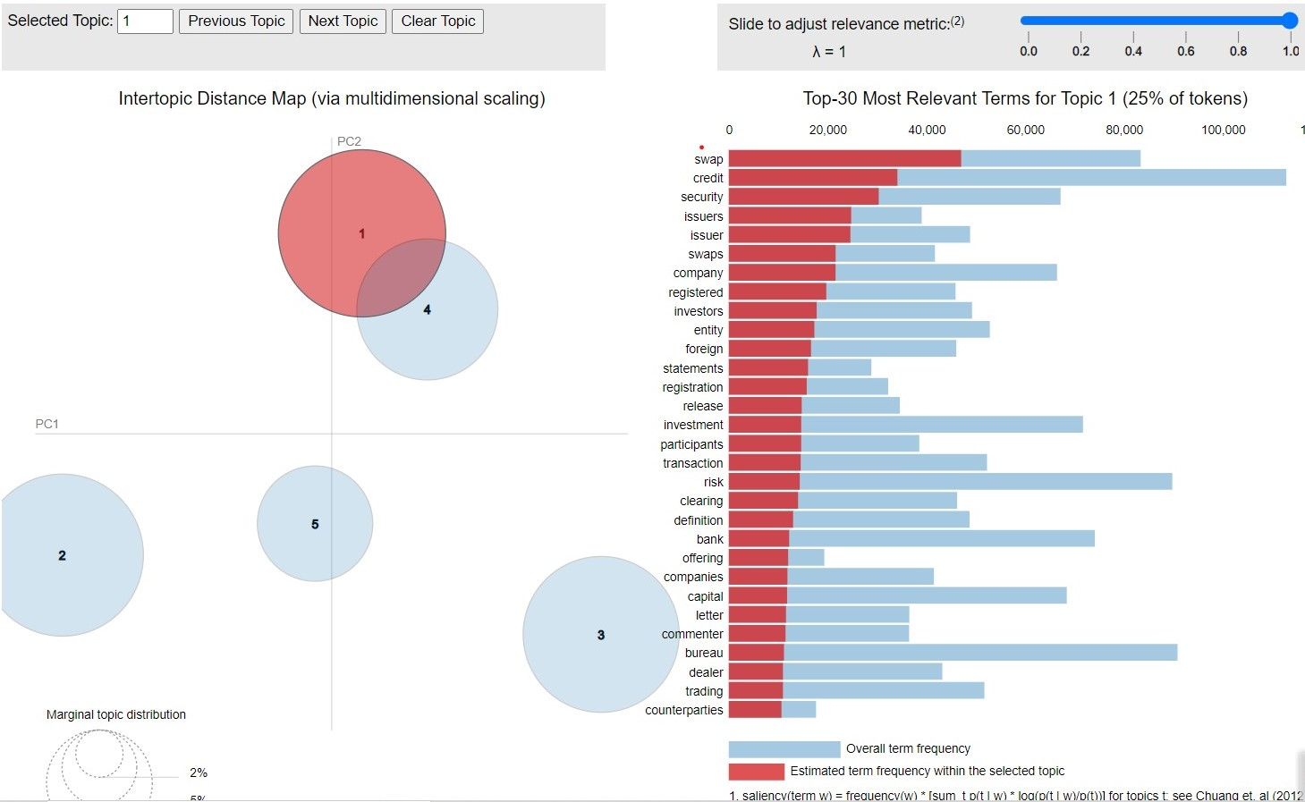
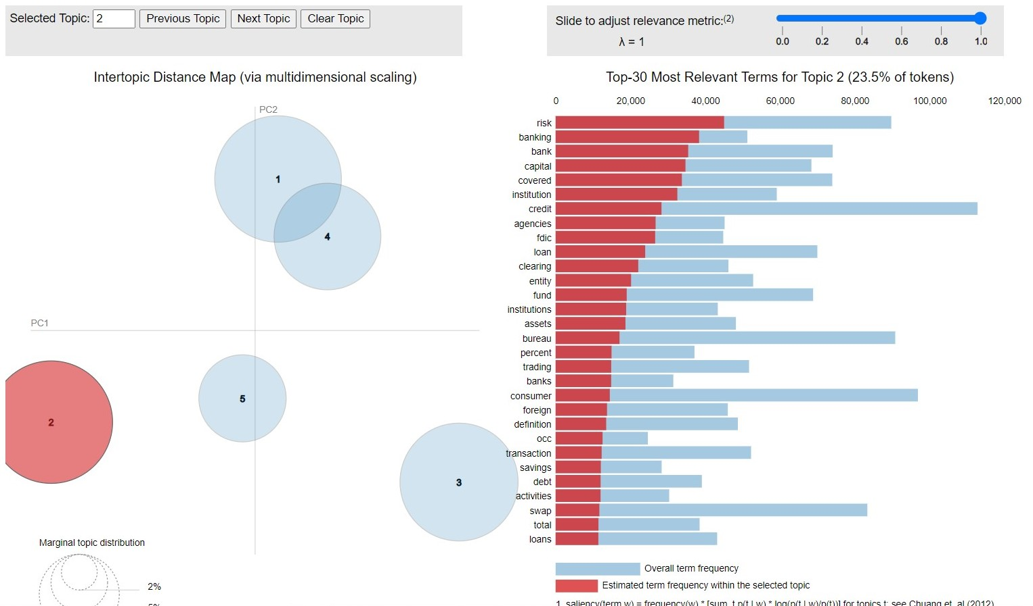
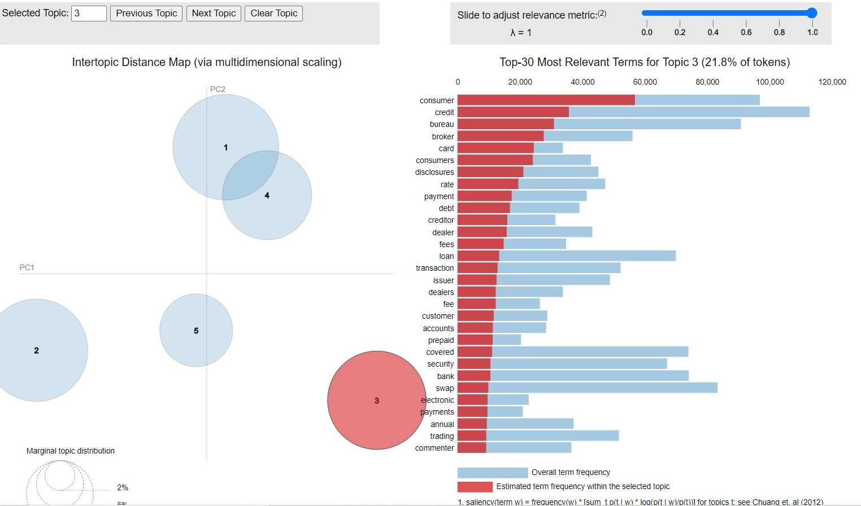
What were the common regulatory priorities of these agencies from 2001 through 2006?
Upon clustering data, of 2001 - 2006 we got that these were the common priorities of
the agencies.
Credit swaps: According to Collins Dictionary, "a credit swap is a kind of insurance against credit risk where a third party agrees to pay a lender if the loan defaults, in exchange for receiving payments from the lender." The entities involved in this financial transaction seem to be companies and investors.
Risks in loans: This is confirmed by the fact that other keywords such as "FDIC", the Federal Deposit Insurance Corporation, also appear here. Furthermore, the agencies seem to be concerned with the "assets" and "capital" backing these loans.
Consumer financial protection: This is a federal agency that ensures " banks, lenders, and other financial companies treat you fairly." The entities involved are brokers, creditors, dealers, and consumers. The types of financial transactions that mainly occur are loans, which may be in the form of credit card debt, and its payment.

Slide 4
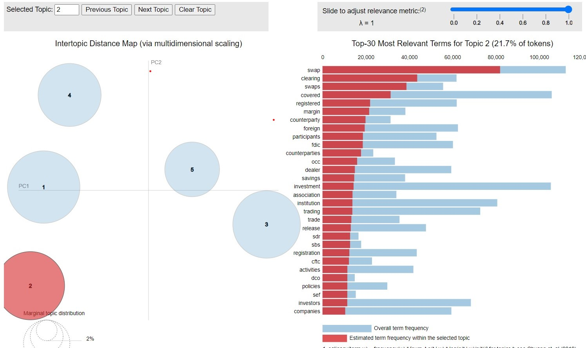
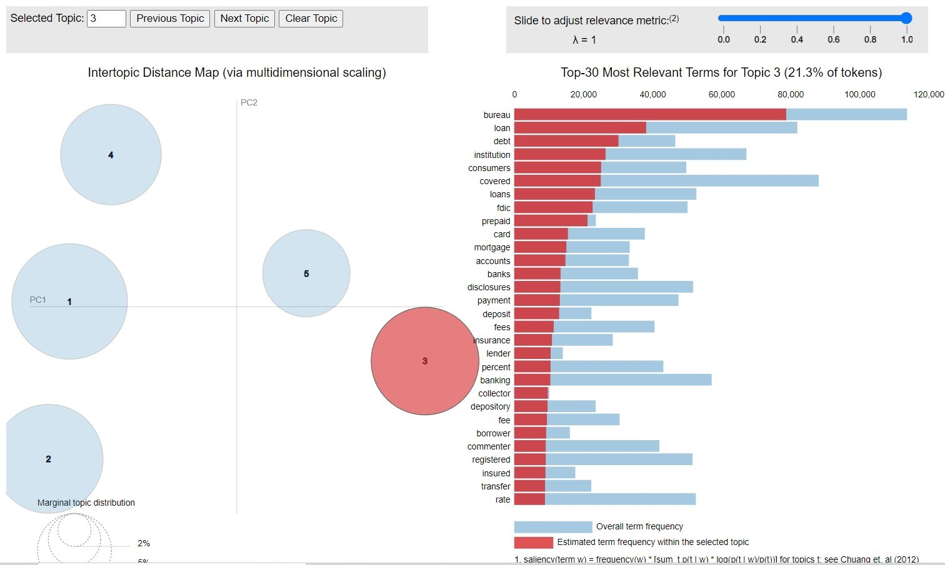
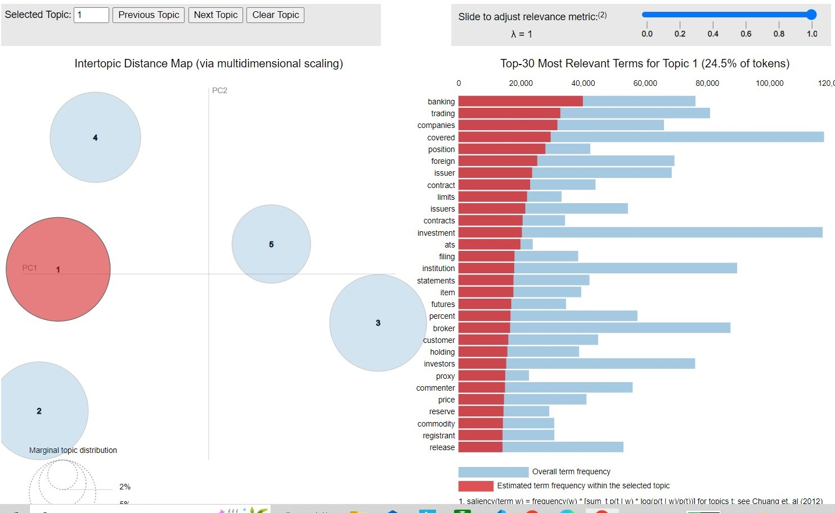
What new topics and issues emerged from 2007 through 2012? (And what topics went away?)
Covered positions. This is a new topic in this era. According to Investopedia, "To cover is to take a defensive action to lower the risk exposure of a position, investment, or portfolio of investments. In short selling, a cover refers to buying the security you sold short in order to close out the position." The entities involved in this transaction seem to be large banks.
Cleared credit swaps. This topic remained the same as the last era, however, some new terms appeared. These terms included "counterparty" and "clearing". This indicated that the agencies were mainly involved with ensuring that promises made by two entities would actually be fulfilled in the wake of the 2008 financial crisis.
Mortgages, Loans, and Debts. The entites involed are brokers, creditors, consumers, and institutions. Here, in addition to the topics in the last era, we see a relatively new interest in mortgages. This may be due to the house bubble burst during the 2008 Financial Crisis.
Notes:
Similarly i found new topics and the difference from first group of clusters

Slide 5
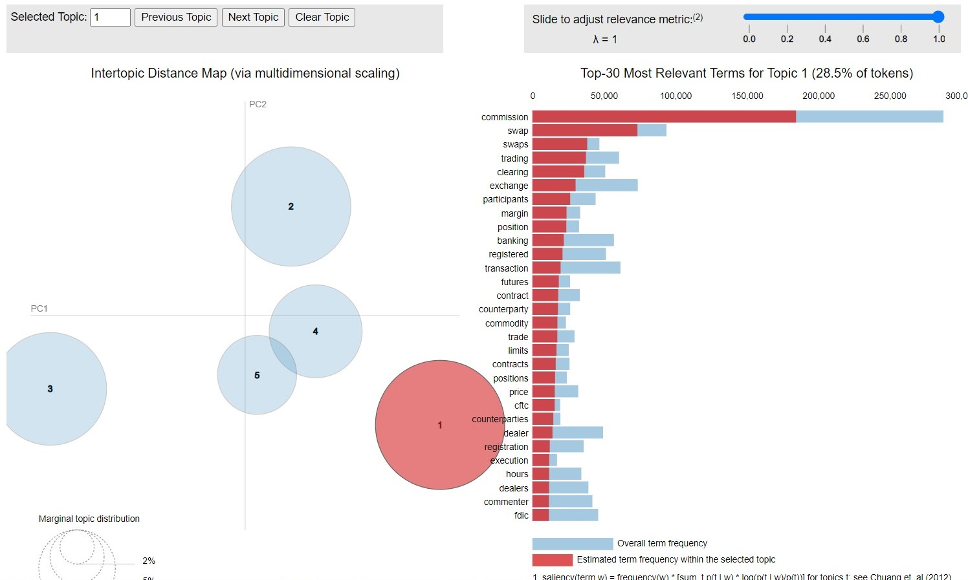
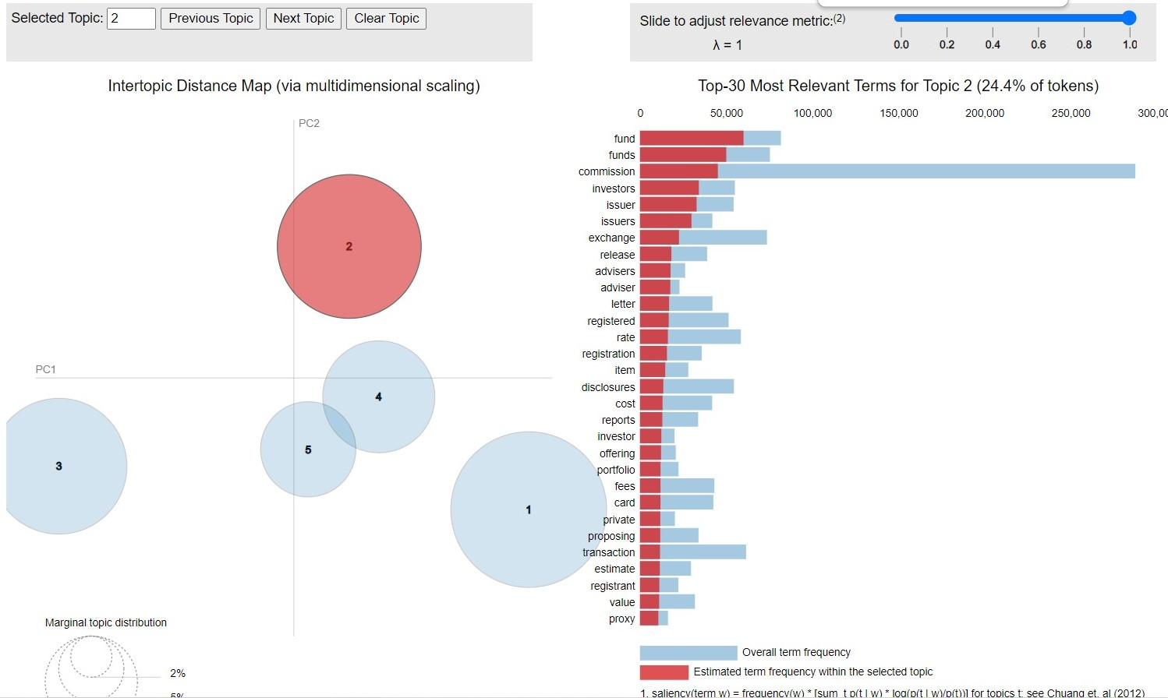
Impact of the Coronavirus Pandemic
Participation. Due to COVID-19, many individuals shrank many aspects of their life including their financial decisions. Many priorities during the COVID-19 pandemic focused on increasing retention and expanding their reach.
Debt management. Many individuals suffered job losses and economic struggles during the COVID-19 pandemic. Many documents mentioned policies on debt and how to manage and deal with this issue.

Slide 6
THANK YOU!!
NoteBook Link

